Slide 1
UAV / Drone Technology innovations
P.L.N. Raju, NESAC

Slide 2
UAV training so far and your understanding
How UAV is different from RS?
What height the UAV you can fly?
Weight of UAVs and categories
How you control the flying of UAVs
What are the safety features of UAVs
Different terminologies used in UAVs VLOS /BVLOS /UIN /UAOP /AGL/ RTH/ ADC /FIC /FTO / NPNT /RPAS etc.
What are the safety measures in UAV operation
What is flight planning?
What are different applications?
Clarifications, if any?
Notes:
RPAS: Remotely Piloted Aircraft System
UAOS: Unmanned Aircraft Operator Permit
RTH: Return To Home
ADC: Air Defense Clearance
FIC: Flight Information Centre / FTO: Flight Training Organisation

Slide 3
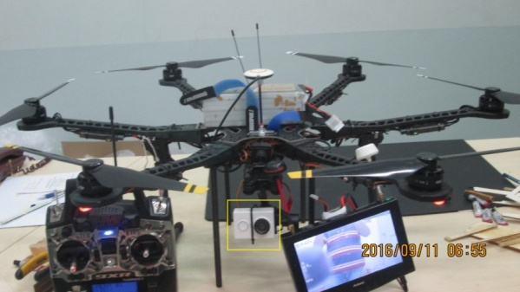
UAVs Comparative Analysis
.
Sl. No. | Product Name | Specifications
1 | Parrot DISCO FPV | FPV; Precise & Assisted; 45 min; 1.24 miles; $ 1,299.99
2 | Parrot BEBOP 2 FPV | Immersive Flying; 1.24 miles; 25 min; $ 699.99
3 | STAKEOUT - High Endurane,Medium Altitude, Micro UAV | 5 Km; 90 min; payload capacity up to 1.0 Kg; Manual, Semi, Fully Autonomous
4 | Lookout VTOL - High Performance, High Endurance UAS | 5 Km; 45 min; payload capacity up to 2 Kg; Manual, Semi, Fully Autonomous
5 | NETRAv2 UAV | 4 Km; 40 mins; Max. Launch Altitude 200; Safe landing facility
6 | Sparrow-RTK | 4 Km; 50 min; Fully autonomous data capture
7 | InSight-AUS | 4 Km; 30 min; Fully autonomous data capture
8 | MAVIC Pro | 7 Km; 27 min; 12 MP Camera; $ 999
9 | Phantom 4 Pro | 7 Km; 30 min; 20 MP Camera; $ 1,499
10 | INSPIRE 2 | 7 Km; 25 min; multi camera support; $ 2,999
11 | Matrice 600 Pro | 5 Km; ~ 20 min depending on the payload; $ 4,999

Slide 4
Drone technology innovations
On board live data processing
Military grade drones (air strikes)
Germany e-car (Schuh) / Dubai air taxi
services (eHang)
Drones to fight against ISIS (terrorism) (USA 20M$)
Collision avoidance
Follow me option
Ground Collision avoidance with LiDAR
Air Dog Drone
Recording everything at the control station
for security reasons

Slide 5
Drone technology innovations
Pocket size and miniature drones
Intel 500 drones light show (world record)
Mobile based operations
Autonomous flying, flight planning
Medical drones / ambulance drones
RTK /PPK based measurements
PAN/MX/HS/LiDAR cameras in UAV drones
GPR in UAVs
Many more……..

Slide 6
DGCA regulations for UAV
Effective: 01st December, 2018
Applicable for All civilian organizations: Central Govt./State Govt./PSUs/Private industries/Academia etc.
Except: Indian Army, Indian Air force, Indian Navy, Police, Central Reserve forces, Security agencies
Classification of UAS
• Classification of UAS as per weight
‒ Nano : ≤ 250 gm
‒ Micro : > 250 gm and < 2 kg
‒ Mini : > 2 kg and < 25 kg
‒ Small : > 25 kg and < 150 kg
‒ Large : > 150 kg
Application Process:
Online: Digital Sky Platform

Slide 7
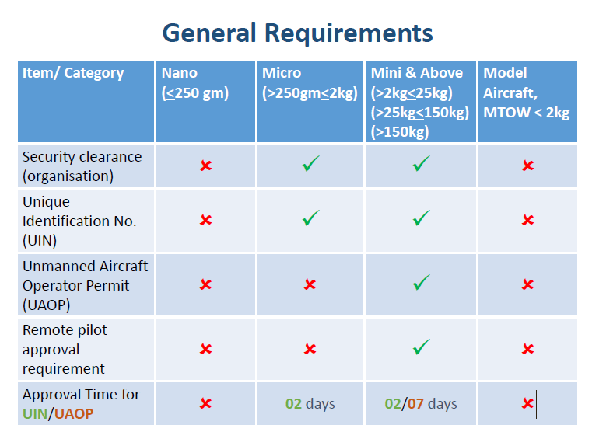
Notes:
MTOW: Maximum Take Off Weight

Slide 8
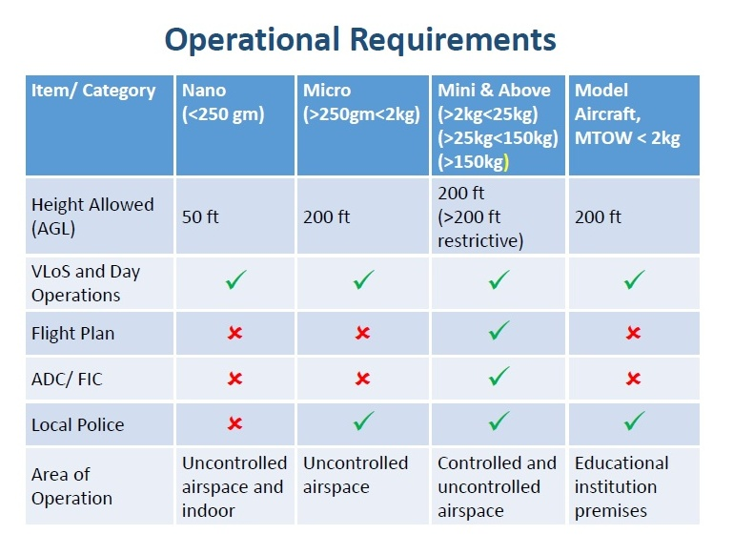
Notes:
ADC: Air Defense Clearance
FIC: Flight Information Centre

Slide 9
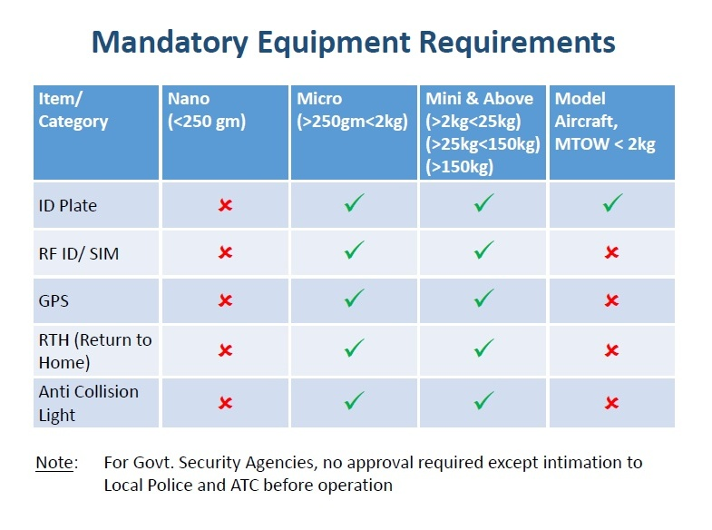

Slide 10
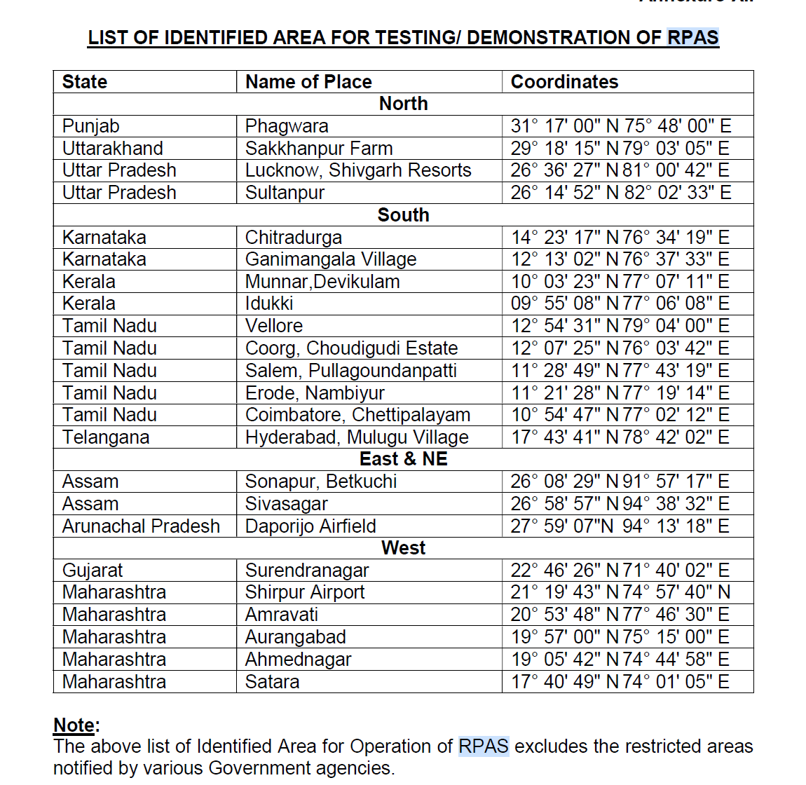

Slide 11
Remote Pilot Training Requirements
1. Remote pilot shall have attained 18 years of age, having passed 10th exam in English, and undergone ground/practical training
2. The ground training shall be obtained at any DGCA approved Flying Training Organization (FTO), and include the following theory subjects:
a) Basic Radio Telephony (RT) techniques including knowledge of radio frequencies.
b) Flight Planning and ATC procedures.
c) Regulations specific to area of operations.
d) Basic knowledge of principles of flight and aerodynamics for fixed wing, rotary wing, and hybrid aircraft.
e) Airspace Structure and Airspace Restrictions with knowledge of No Drone Zones
f) Basic Aviation Meteorology.

Slide 12
Remote Pilot Training Requirements
3. The practical training shall comprise of RPA in flight having live component, and/ or Simulated flight training to demonstrate control of RPA throughout its operating conditions, including safe recovery during emergencies and system malfunction. Minimum syllabus and curriculum for training capsule for Remote Pilot is given at ANNEXURE-IX of CAR.
4. The requirements contained above of this CAR are not applicable for Nano and Micro category RPA pilots intending to operate in uncontrolled airspace. However, the owner and user shall be fully aware of responsibilities for all aspects of flight safety during such operations
Notes:
RPA: Remotely Piloted Aircraft / CAR: Civil Aviation Requirements

Slide 13
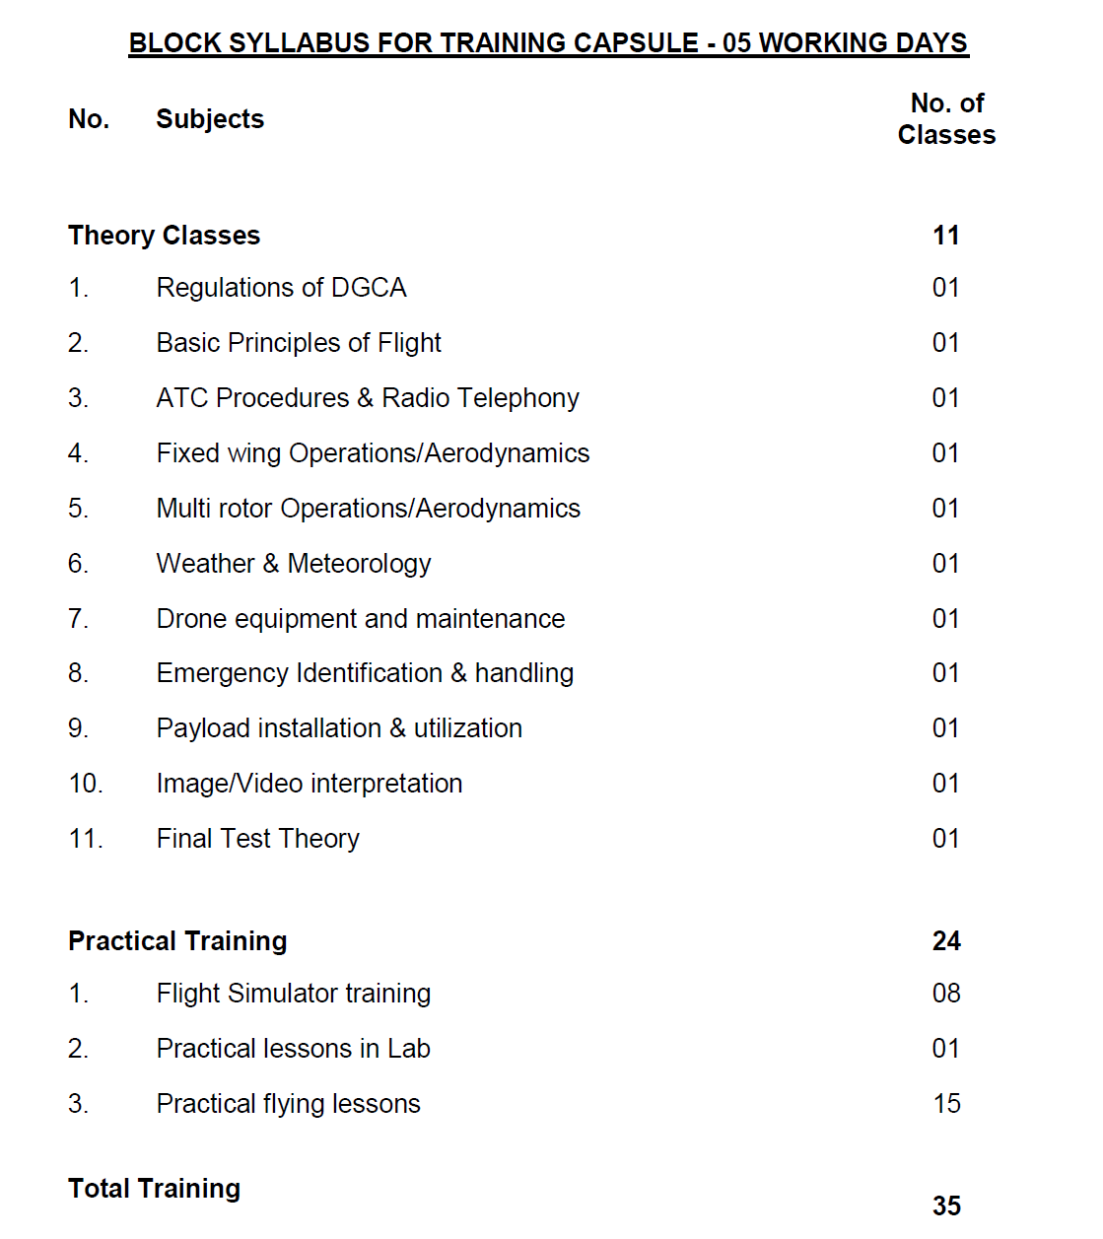

Slide 14
Legal Obligations:
UIN and/or UAOP issued by DGCA shall not:
Confer on RPAS operator any right against the owner or resident of any land or building or over which the operations are conducted, or prejudice in any way the rights and remedies which a person may have in respect of any injury to person or damage to property caused directly or indirectly by the RPA.
2. Absolve the operator/remote pilot from compliance with any other regulatory requirement, which may exist under the State or Local law.
Insurance:
All civil RPA operators shall have insurance, with liability that they might incur for any damage to third party resulting from the accident/incident.
Enforcement Action:
In case of violation of provisions of this CAR/approved operating conditions the UIN/UAOP issued by DGCA shall be suspended/cancelled.
Breach of compliance to any of the requirements and falsification of records/ documents shall attract penal action including imposition of penalties as per applicable IPCs (such as 287, 336, 337,338 or any relevant section of IPC)
Necessary actions shall be take as per relevant sections of the Aircraft Act 1934/ the Aircraft Rules 1937 or any statutory provisions.
Notes:
RPAS: Remotely Piloted Aircraft System

Slide 15
DGCA regulations for UAV
No Drone Zone
Above Obstacle Limitation Surfaces (OLS) of operational aerodrome
Within permanent/temporary Prohibited, Restricted and Danger Areas including Temporary Reserved Area (TRA) and Temporary Segregated Area (TSA) as notified by AAI
Within 5 Km (2.7 NM) radius from Aerodrome Reference Point (ARP) of Operational aerodrome
Within 50 km from international border which includes Line of Control (LoC), Line of Actual Control (LAC) and Actual Ground Position Line (AGPL)
Beyond 500m (horizontal) into sea from coast line provided the location of ground station is on fixed platform over land

Slide 16
DGCA regulations for UAV
No Drone Zone
Within 5 km radius from Vijay Chowk in Delhi
Within 500 m radius from strategic locations notified by Ministry of Home Affairs and military installations.
From mobile platforms i.e. moving vehicle, ship or aircraft
Over eco-sensitive zones around National Parks and Wild life sanctuaries notified by MoEF & CC without prior permission
Operation of Nano and Micro UAS inside covered premises in No Drone Zone may be carried out subject to permission from local police authorities

Slide 17
DGCA regulations for UAV
No Drone Zone
Within a distance of 5 km from perimeter of airports at Mumbai, Delhi, Chennai, Kolkata, Bengaluru and Hyderabad
Within a distance of 3 km from perimeter of any civil, private or defense airports.
Within 3km from radius of State Secretariat Complex in State Capitals.

Slide 18
Drone Eco System policy roadmap (January, 2019)
Recommendation for CAR 2.0:
Beyond Visual line of sight (BVLOS)
Autonomous missions
Drone Corridor
Airworthiness
UAS traffic management System (UTM)
Drone ports
Payload/Cargo
Make in India
Insurance
Improved Pilot training
Night time operations
Establishment of a Drone Directorate under DGCA

Slide 19
The mandatory requirements to fly drone India include:
GPS
Return-to-home (RTH)
Anti-collision light
ID plate
A flight controller with flight data logging capability
RF ID and SIM/No Permission No Take off (NPNT)

Slide 20
Foreigners are currently not allowed to fly drones in India. For commercial purpose, they need to lease the drone to an Indian entity who in-turn will obtain Unique Identification Number (UIN) and UAOP from DGCA.
Thank you all and wish you an
exciting Training Program

